Slide 1
Probabilities
Tomas Karpati MD tc.datascience@gmail.com
054-2002430

Slide 2
Probability
הסתברויות:
הסתברות לאירועים תלויים ועצמאיים
משפט בייסיאנית והסתברות מותנית
Prior and posterior distribution
סימולציות מונטה-קרלו
מודלים שרשרת מרקוב

Slide 3
Probability
שיעור המקרים שבהם מתרחש אירוע
הסתברות יכול להיות על אירוע אחד או שורה של אירועים
במקרה של מספר אירועים, חייבים להבדיל בין ארבעה סוגים של אירועים:
אירועים בלתי תלויים
אירועים תלויים
אירועים סותרים
אירועים שאינם בלעדיים
החישוב של ההסתברות שונה בכל אחד מהסוגים

Slide 4
Probability of an event
Single event
אירועים בודדים
ההסתברות שאירועה יתרחש הינו היחס של האירוע ביחס לסה”כ האירועים האפשריים
P(A) = n/N
Independent events
Dependent events
Mutually exclusive events
Non-mutually exclusive events

Slide 5

Probability of an event
Single event
P(A) = n/N
Independent events
P(e) = 1:2
Dependent events
½ = 0.5
Mutually exclusive events
P(e) = 50%
Non-mutually exclusive events

Slide 6

Probability of an event
Single event
P(A) = n/N
Independent events
P(5) = 1:6
Dependent events
⅙ = 0.167
Mutually exclusive events
P(5) = 16.7%
Non-mutually exclusive events

Slide 7

Probability of an event
Single event
P(A) = n/N
Independent events
P(10) = 4:52
Dependent events
4/52 = 0.077
Mutually exclusive events
P(10) = 7.7%
Non-mutually exclusive events

Slide 8
Probability of an event
Single event
אירועים בלתי תלוים
בינתן שני אירועים, כאשר התוצאה של אחד מהם לא משפיע על התוצאה של השני
P(A AND B) = P(A) * P(B)
P(A ∩ B) = P(A) * P(B)
Independent events
Dependent events
Mutually exclusive events
Non-mutually exclusive events

Slide 9

Probability of an event
Single event
P(A ∩ B) = P(A) * P(B)
Independent events
P(5 ∩ 5) = ⅙ * ⅙
Dependent events
1/36 = 0.0278
Mutually exclusive events
Non-mutually exclusive events
P(5 ∩ 5) = 2.78%

Slide 10

Probability of an event
Single event
P(A ∩ B) = P(A) * P(B)
Independent events
P(e ∩ e) = ½ * ½
Dependent events
¼ = 0.25
Mutually exclusive events
Non-mutually exclusive events
P(e ∩ e) = 25%

Slide 11
Probability of an event
Single event
אירועים תלוים
בינתן שני אירועים, כאשר התוצאה של אחד מהם משפיע באופן ישיר על התוצאה של השני
P(A ∩ B) = P(A) * P(B|A)
Independent events
Dependent events
Mutually exclusive events
Non-mutually exclusive events

Slide 12

Probability of an event
Single event
P(A ∩ B) = P(A) * P(B|A)
Independent events
P(K ∩ A) = 4/52 * 4/51
Dependent events
16/2652 = 0.006
Mutually exclusive events
Non-mutually exclusive events
P(K ∩ A) = 0.6%

Slide 13

Probability of an event
Single event
P(A ∩ B) = P(A) * P(B|A)
Independent events
P(A ∩ A) = 4/52 * 3/51
Dependent events
12/2652 = 0.0045
Mutually exclusive events
Non-mutually exclusive events
P(A ∩ A) = 0.45%

Slide 14
Probability of an event
Single event
אירועים סותרים
בינתן שני אירועים, ההסתברות שהתוצאה תהיה אחד משניהם, אך לא שניהם
P(A OR B) = P(A) + P(B)
P(A ∪ B) = P(A) + P(B)
Independent events
Dependent events
Mutually exclusive events
Non-mutually exclusive events

Slide 15
Probability of an event
Single event
P(A ∪ B) = P(A) + P(B)
Independent events
P(5 ∪ 6) = ⅙ + ⅙
Dependent events
2/6 = 0.333
Mutually exclusive events
Non-mutually exclusive events
P(5 ∪ 6) = 33.3%

Slide 16
Probability of an event
Single event
P(A ∪ B) = P(A) + P(B)
Independent events
P(K ∪ A) = 4/52 + 4/52
Dependent events
8/52 = 0.154
Mutually exclusive events
Non-mutually exclusive events
P(K ∪ A) = 15.4%

Slide 17
Probability of an event
Single event
אירועים שאינם בלעדיים
בינתן שני אירועים, ההסתברות שהתוצאה תהיה אחד משניהם או שניהם
P(A OR B) = P(A) + P(B) - P(A AND B)
P(A ∪ B) = P(A) + P(B) - P(A ∩ B)
Independent events
Dependent events
Mutually exclusive events
Non-mutually exclusive events

Slide 18
Probability of an event
Single event
P(A ∪ B) = P(A) + P(B) - P(A ∩ B)
Independent events
Numbers that divide by 2
OR
Numbers that divide by 3
Divide by 2: [2, 4, 6]
Divide by 3: [3, 6]
Dependent events
Divide by 2 AND 3: [6]
Mutually exclusive events
P(d2 ∪ d3) = 3/6
+2/6
-1/6
= 4/6
Non-mutually exclusive events
P(d2 ∪ d3) = 0.666 = 66.6%

Slide 19
Bayesian Inference
Bayesian inference is a method of statistical inference in which Bayes' theorem is used to update the probability for an hypothesis as more evidence or information becomes available.

Slide 20
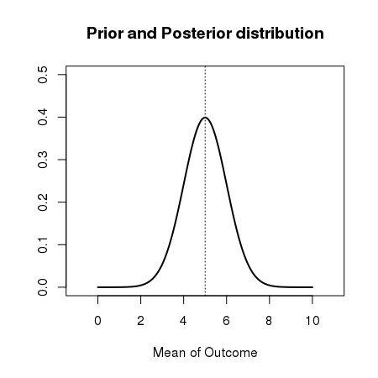
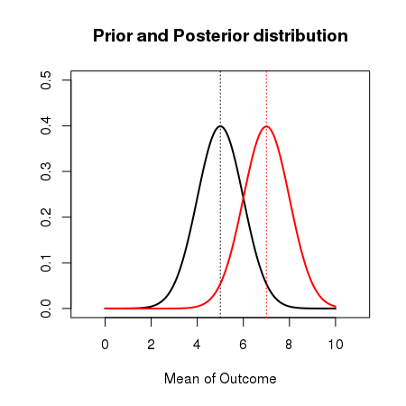
Prior and Posterior distribution
A prior distributions represents what we believe the probability of an event will be. If we toss a coin 10 times, we believe that the number of coins that fall on a certain side will be 5 (50% probabilities).
However, on a trial we get that 7 coins falled on the same side. Thus, the data driven probability (called the Posterior probability) shows a different distribution.

Slide 21
Prior and Posterior distribution
When we believe that we know the prior distribution (like in the case of coins, dices, poker cards or well known diseases) we say that the prior is informative.
When we are not sure of our prior (like in some uncommon diseases) and we have to imagine a possible prior distribution, we say that the prior is uninformative.
In cases of informative priors, the posterior will be determined by both the prior and the data driven probability. The posterior is calculated using the Bayes Theorem
In cases of uninformative priors, the posterior will be determined by the data (data-driven).

Slide 22
Bayes Theorem
The conditional probability for dependent events says that:
P(A ∩ B) = P(A) * P(B|A)
P(B ∩ A) = P(B) * P(A|B)
P(A ∩ B) = P(A|B) * P(B) = P(B|A) * P(A)
Bayes
Theorem
P(A|B) = P(B|A) * P(A) / P(B)

Slide 23
Bayesian Inference
Bayesian inference involve the following steps:
Define the prior distribution that incorporates your subjective beliefs about a parameter (in your example the parameter of interest is the proportion of left-handers). The prior can be uninformative or informative.
Get the data.
Update your prior distribution with the data using Bayes' theorem to obtain a posterior distribution. The posterior distribution is a probability distribution that represents your updated beliefs about the parameter after having seen the data.
Analyze the posterior distribution and summarize it (mean, median, sd, quantiles, ...)

Slide 24
Naive Bayes Algorithm
In R Naive Bayes is implemented in the package ‘e1071’
library(e1071)
mtcars <- data.frame(mtcars)
nbmod <- naiveBayes(am ~ cyl + hp + wt, data=mtcars)
pred <- predict(nbmod,mtcars)
In Python Naive Bayes is implemented in ‘scikit-learn’
from sklearn import datasets
iris = datasets.load_iris()
from sklearn.naive_bayes import GaussianNB
gnb = GaussianNB()
y_pred = gnb.fit(iris.data, iris.target).predict(iris.data)

Slide 25
Monte-Carlo Simulations
Input 1
Event
Outcome
Input 2
Input 3
Input 4

Slide 26
Markov Chain Models
Markov Chains are dynamic models of discrete transitions. Those transitions depends only on what is occurring now and are not influenced by past events.

Slide 27



Markov Chain Models
State
p= 0.15
Work From Home
Work in Coffee shop
p = 0.10
p = 0.70
p = 0.85
Work in Office
p = 0.05
p = 0.30
p = 0.00
p=0.20
p = 0.65

Slide 28
Markov Chain Models
Probability Transition Matrix
Starting Probability
Vector
From
 | Home | Office | Coffee shop
Home | 0.20 | 0.30 | 0.15
Office | 0.70 | 0.65 | 0.85
Coffee shop | 0.10 | 0.05 | 0.00
0.27
0.68
0.06
0.20
0.70
0.10
1.0
0.0
0.0
0.20
0.70
0.10
To

Slide 29
Frequentists vs Bayesians
At the 19th century Bayesian inference was very popular
In the 20th century Frequentist inference gain a lot of popularity and credibility. Bayesian inference was abandoned.
Today, Bayesian inference is gaining many adepts and there are debates about which is better.
At the end, the final results of both are very similar, but the way the calculations are done is different.

Slide 30
Frequentists vs Bayesians
Bayesian inference
Uses priors
Logically impeccable
Probabilities can be interpreted
Prior is subjective
Frequentist inference
No prior Objective –everyone gets the same answer
Logically complex
Conditional probability of error is often misinterpreted as total probability of error
Requires complete description of experimental protocol and data analysis protocol before starting the experiment. (This is both good and bad)

